Slide 1

Traffy Fondue
Project

Slide 2
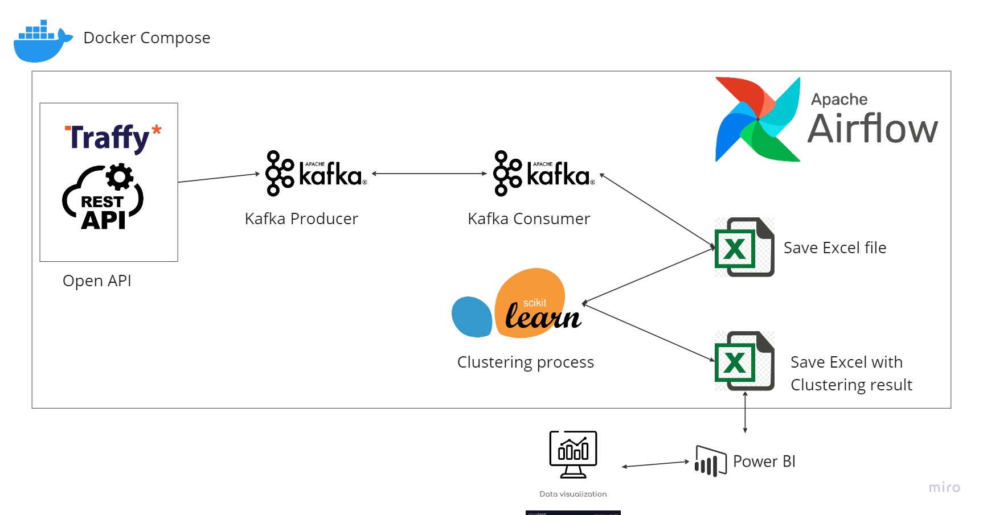
Project Workflow
Machine Learning
Data Engineer
Data Visualization

Slide 3

Data Engineer
Airflow
Open API
Kafka
Machine Learning & Data Preparation
Pandas
Scikit-Learn
Data Visualization
Power BI

Slide 4
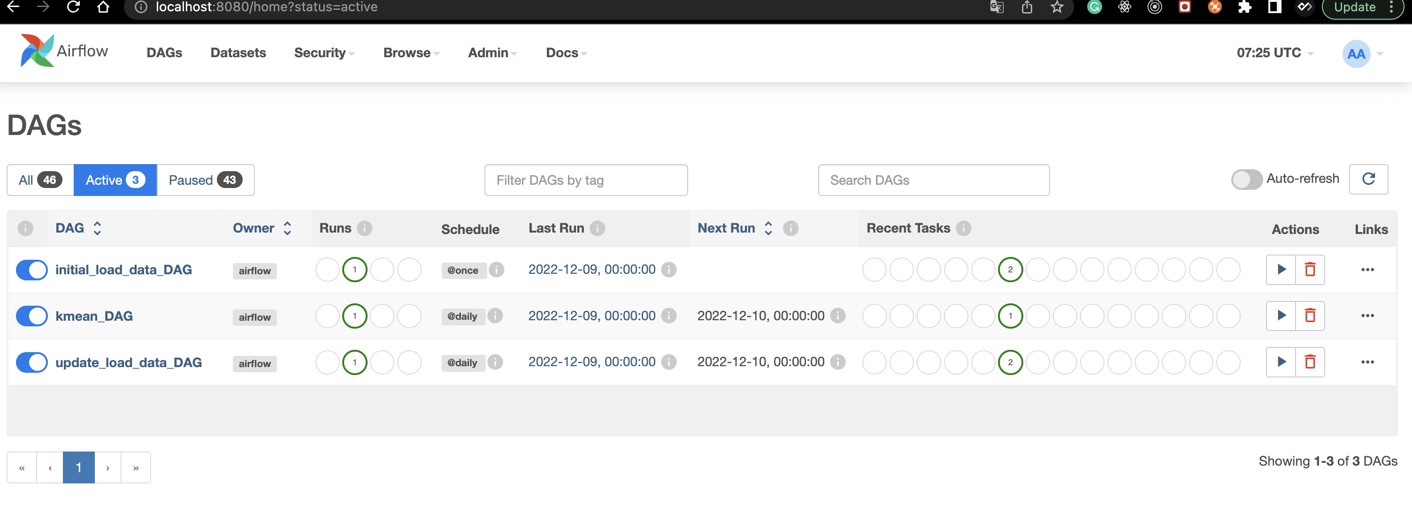
All Airflow DAG

Slide 5
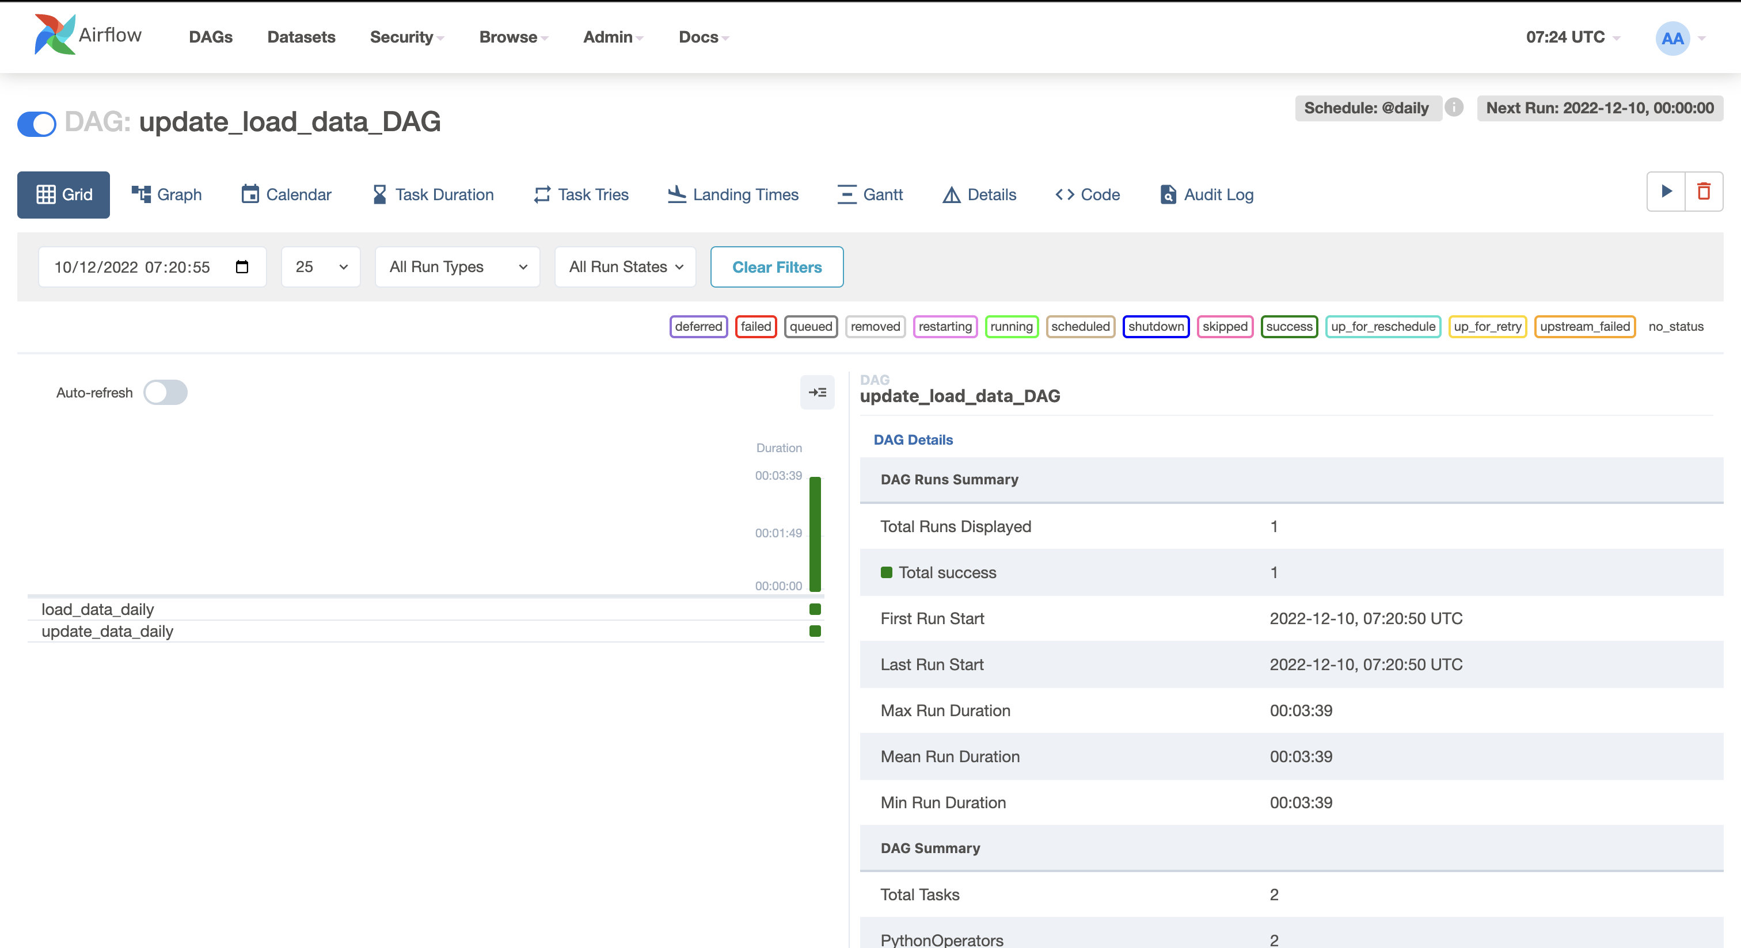
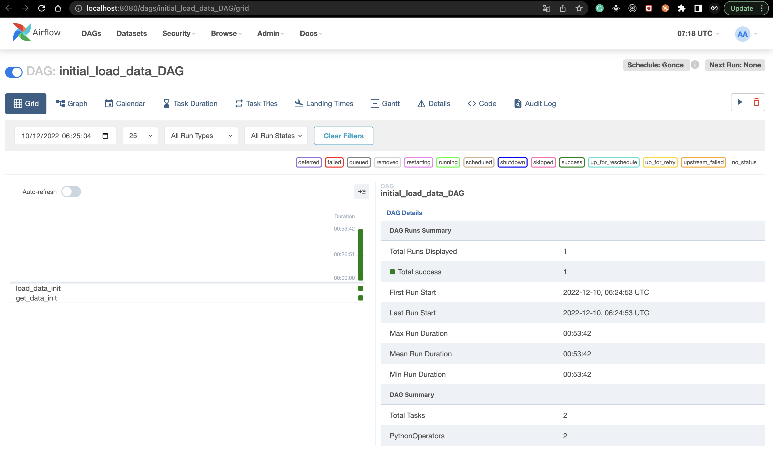
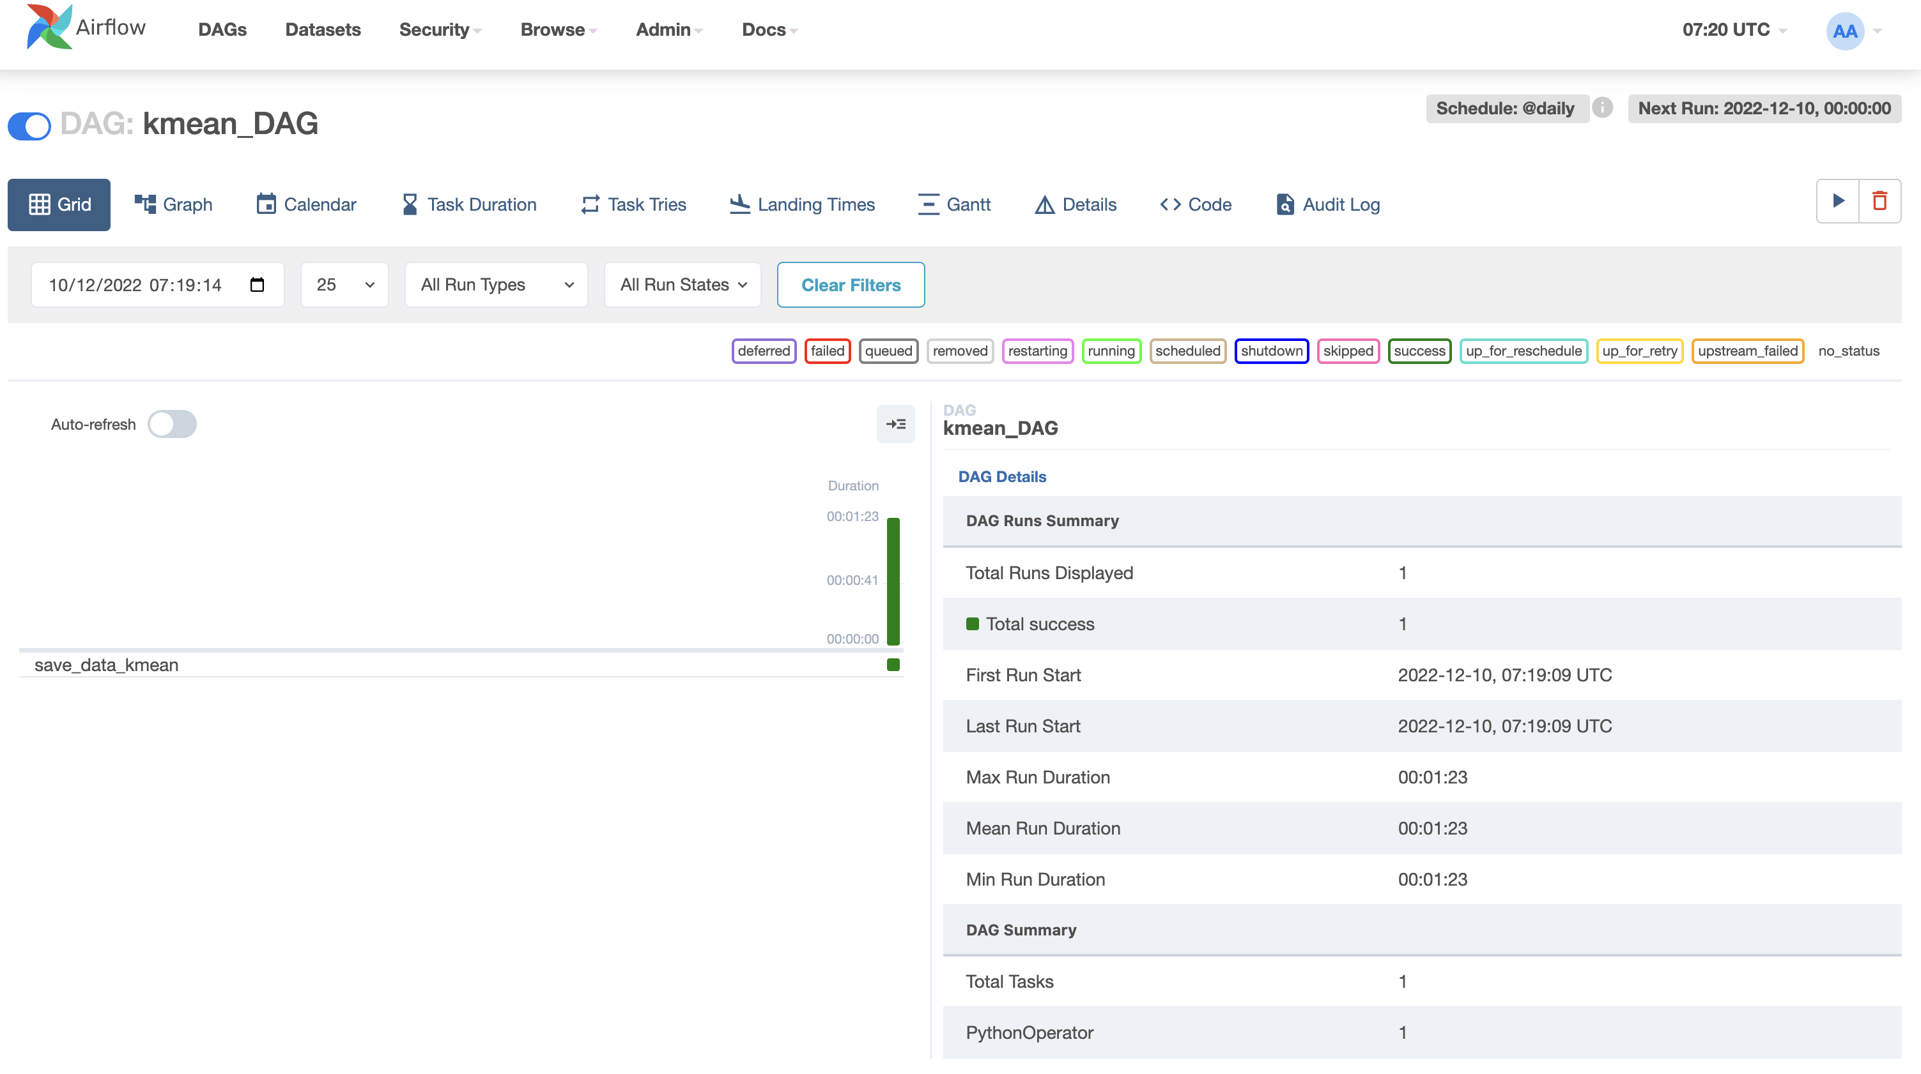
Example Airflow DAG

Slide 6
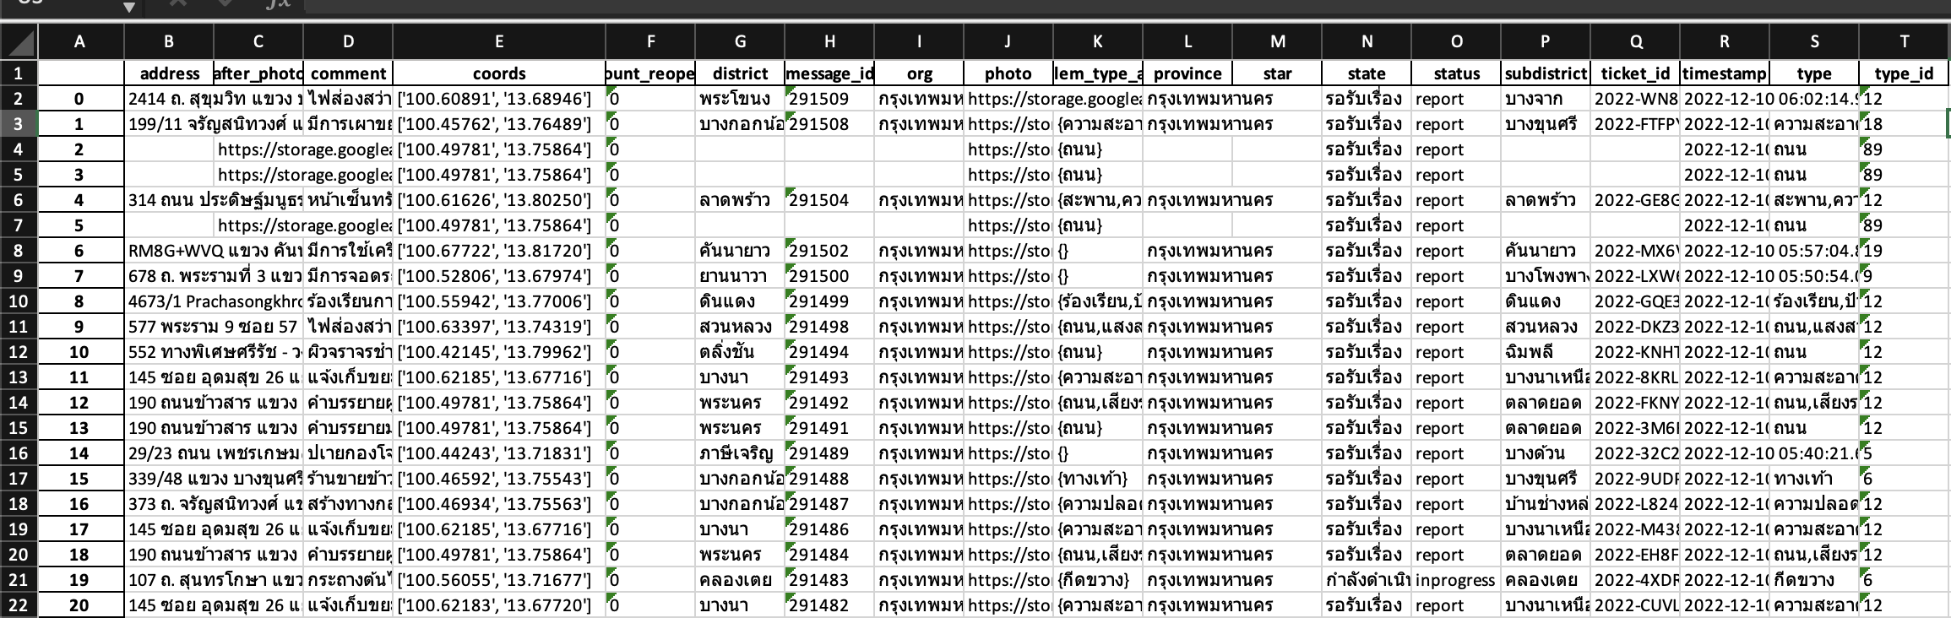
Sample

Slide 7
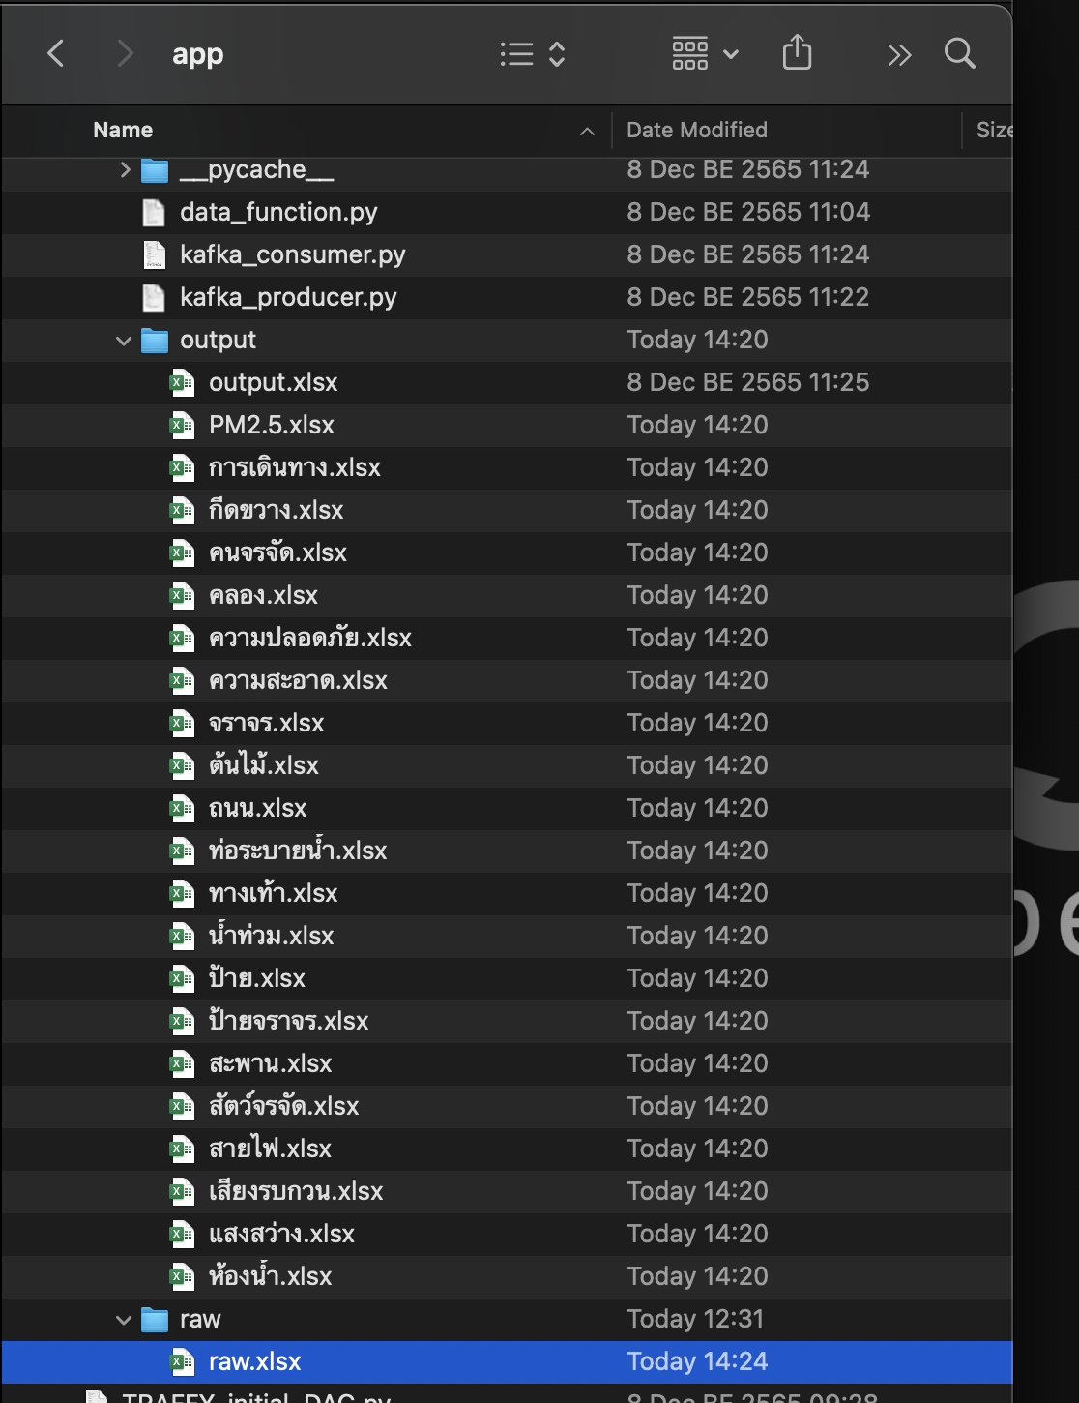
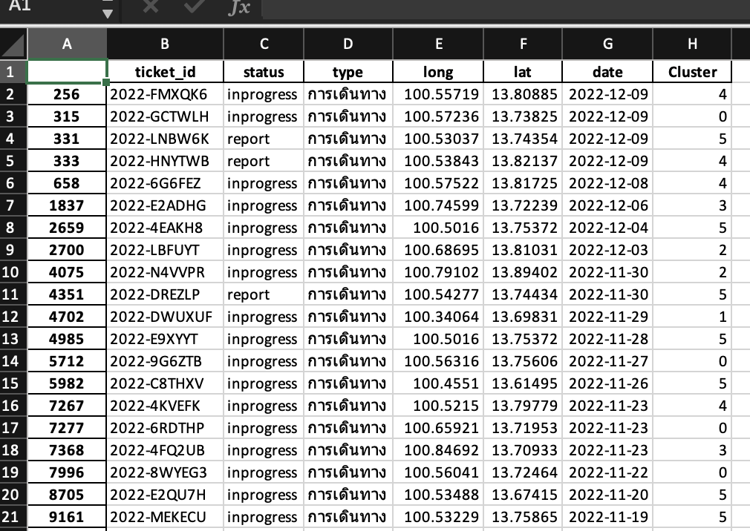
Output

Slide 8
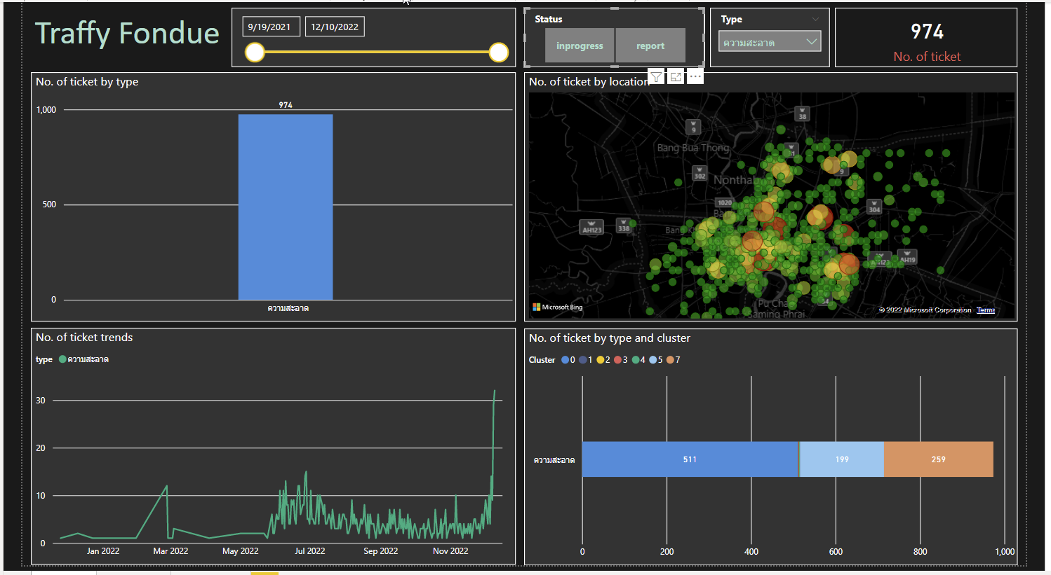
Result

